Slide 1
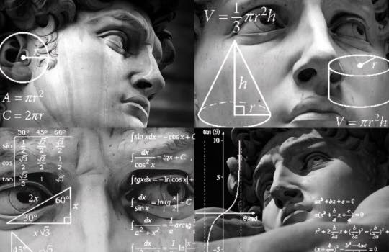

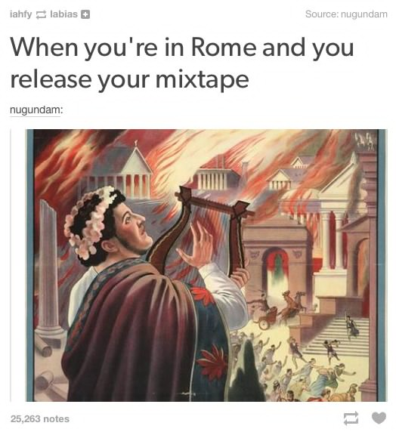
Latin
And other weird things about Rome

Slide 2
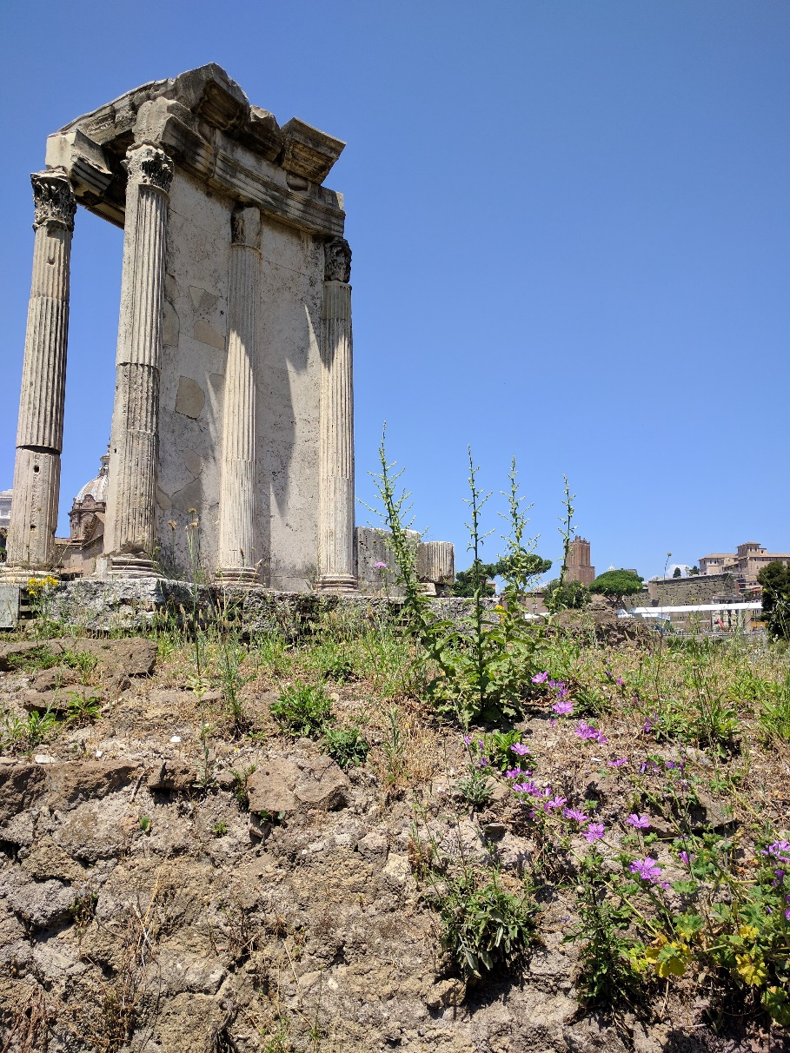
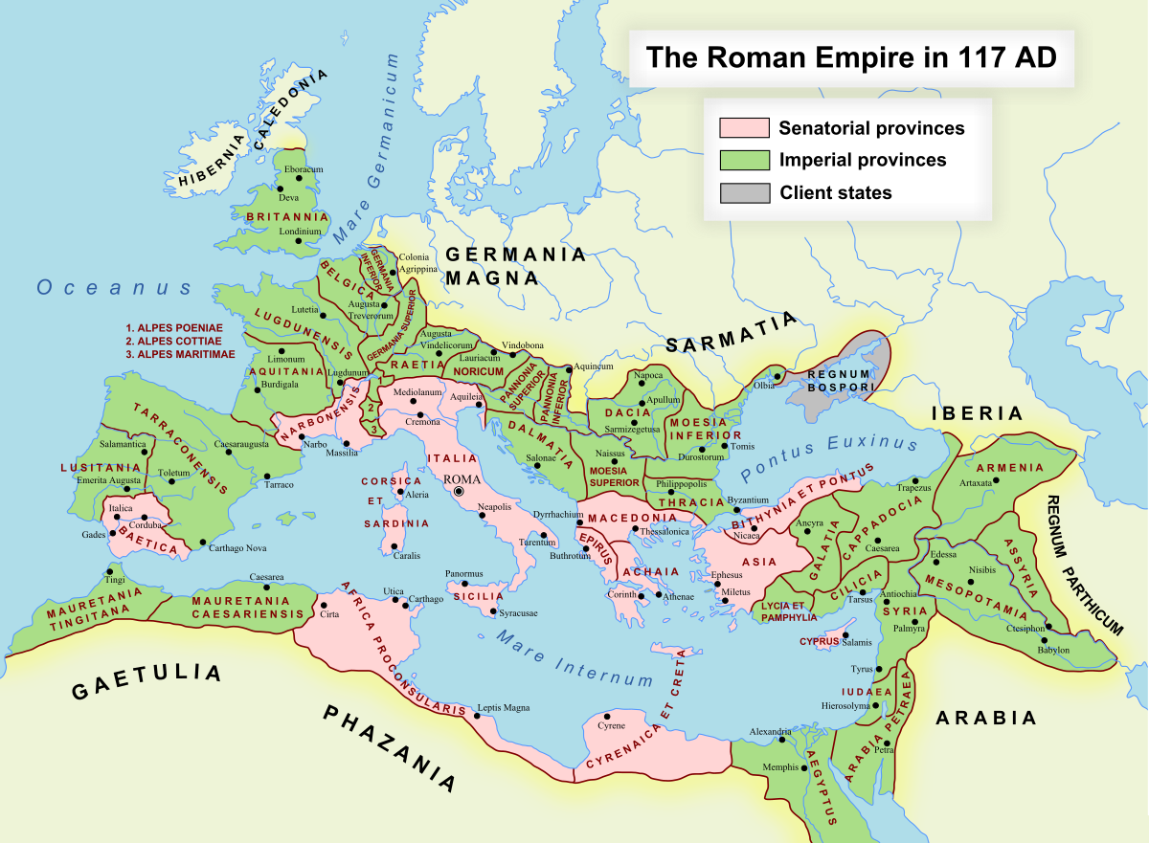
Origin of Rome
Rome went from a tiny village to a giant empire
Founded April 21, 753 BCE
  Romulus and Remus
Roman Forum: center of the city
  7 hills
  Forum lies between Capitoline and Palatine
Notes:
photo is Temple of the Vestal Virgins, built by Numa Pompilius (one of 7 kings of early Rome)
other hills: Aventine, Caelian, Esquiline, Quirinal, Viminal
By Andrei nacu at English Wikipedia - Transferred from en.wikipedia to Commons., Public Domain, https://commons.wikimedia.org/w/index.php?curid=3274724

Slide 3
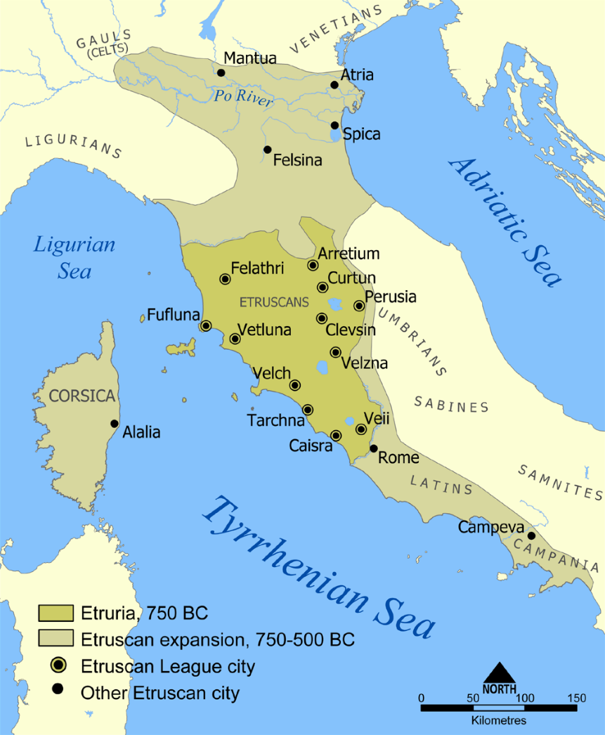
Development of Latin
Not actually the most extra language ever but very close (see: ancient Greek)
  lacks: dual person, middle voice, aorist tense, and operative/benedictive moods
Language family: Indo-European
  related to Umbrian, Faliscan, Venetic, Oscan, Sabellian
  heavily influenced by Etruscan (like French on English)
Earliest inscriptions: 6th c BCE
Advent of literary tradition: late 3rd c BCE
Took over any region conquered by Rome
  “Graeca doctrix omnium linguarum, Latina imperatrix omnium linguarum” –Honorius of Autun
1
Notes:
to understand the evolution and uniqueness of Latin you must understand that of Rome
‘aorist’ is an ‘unmarked’ past tense, i.e. not specified to be either imperfect or perfect
think 11th to 14th c English, or Beowulf to Chaucer
By NormanEinstein - Based on a map from The National Geographic Magazine Vol.173 No.6 June 1988., CC BY-SA 3.0, https://commons.wikimedia.org/w/index.php?curid=241378

Slide 4
Influence of Etruria
Etruscan is not an Indo-European language
  apparently totally unrelated to all other tribes of Italy
  possibly related to Trojans
Etruscans were once the dominant power in Italy
  wealthier, more powerful, and more advanced
  influence on Latin comparable to that of French on English
Story of Aeneas likely Etruscan in origin

Slide 5
Latin Alphabet
Greek alphabet borrowed by Etruscans
  Etruscans wrote right to left
  Didn’t distinguish between [c] and [g]
  Lost numerous letters
  Rule: K before A, Q before V, otherwise C
Etruscan alphabet borrowed by Latin
  Kept some of the oddities
  Reinstated the letters O, B, and D
  All but dropped the letter K
  Readopted Y and Z in 1st c BCE for borrowed Greek words
  Consonantal I and U
Notes:
one of the things that distinguished Latin and related languages is the use of the ‘f’ sound

Slide 6
Pronunciation
Mostly how you’d expect
  especially if you’re familiar with Italian/Spanish vowels
A few caveats:
  c = k
  v = w
  g is always hard
  diphthongs: ae, oe, au
A few examples:
  Cogito ergo sum
  Veni, vidi, vici
  Iulius Caesar

Slide 7
Basic Grammar
No real rules for word order
Nouns are declined and have a gender
Verbs are conjugated and (usually) go at the end of the sentence
  Also there are way too many verb tenses
Declensions / conjugations = patterns of endings
There are no articles
  Because that would just be too extra at this point
  but seriously those are kinda just a modern Western thing (see: Russian)

Slide 8
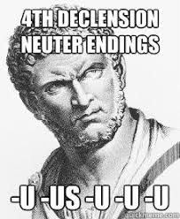
Nouns
Case determines role in sentence
3 genders: feminine, masculine, and neuter
5 declensions that we care about
5 cases in each declension:
  Nominative (subject)
  Genitive (ownership)
  Dative (indirect object)
  Accusative (direct object)
  Ablative (prepositions / miscellaneous)
Notes:
A sixth irregular declension exists but seriously we don’t care about it

Slide 9
Important declensions
1st Feminine
2nd Masculine
2nd Neuter
Singular | Plural
a | ae
ae | arum
ae | īs
am | as
ā | īs
Singular | Plural
us | ī
i | orum
o | īs
um | os
o | īs
Singular | Plural
um | a
i | orum
o | īs
um | a
o | īs
nom
gen
dat
acc
abl
3rd F/M
3rd Neuter
Singular | Plural
-- | ēs
is | um
ī | ibus
em | ēs
e | ibus
Singular | Plural
-- | (i)a
is | (i)um
ī | ibus
-- | (i)a
(i/)e | ibus
nom
gen
dat
acc
abl

Slide 10
Example declensions
puella, puellae: 1st declension feminine, “girl” (stem is puell-)
Singular | Plural
puella | puellae
puellae | puellarum
puellae | puellīs
puellam | puellas
puellā | puellīs
nom
gen
dat
acc
civis, civis: 3rd declension m/f, “citizen” (stem is civ-)
abl
Singular | Plural
civis | civēs
civis | civum
civī | civibus
civem | civēs
cive | civibus
nom
gen
dat
acc
abl

Slide 11
Verbs
given in dictionaries as 4 principal parts
3 moods: imperative, declarative, subjunctive
2 voices: active, passive
4 conjugations
  Patterns of endings for singular/plural + 1st, 2nd, 3rd person
6 tenses (see the timeline below)
Pluperfect
Imperfect
Perfect
Present
Future Perfect
Future
Notes:
conjugations matter more for more exotic tenses (present is pretty much single-vowel differences)

Slide 12
Example Conjugation
amō, amare, amavī, amatus: 1st declension; to love; e.g., Linguam Latinam amō!
Present
Future
Imperfect
Singular | Plural
amō | amamus
amas | amatis
amat | amant
Singular | Plural
amabo | amabimus
amabis | amabitis
amabit | amabunt
Singular | Plural
amabam | amabamus
amabas | amabatis
amabat | amabant
1st
2nd
3rd
Perfect
Pluperfect
Future Perfect
Singular | Plural
amavī | amavimus
amavistī | amavistis
amavit | amavērunt
Singular | Plural
amaveram | amaveramus
amaveras | amaveratis
amaverat | amaverant
Singular | Plural
amaverō | amaverimus
amaveris | amaveritis
amaverit | amaverint
1st
2nd
3rd
Notes:
conjugation is the active voice, declarative mood of a first-conjugation verb

Slide 13
to be
Everyone’s favorite irregular verb
sum esse fui futurus; e.g., Cogito ergo sum
Present
Singular | Plural
sum | sumus
es | estis
est | sunt
1st
2nd
3rd

Slide 14
So that’s it, right?
The entire Latin language, summed up in a bunch of annoying tables?
So let’s give it a shot – translate the Aeneid!

Slide 15
First, Vocab practice
  arma, armorum (2nd n) -- weapons
  vir, viri (2nd m) -- man
  cano, canere, cecini, cantus -- to sing

Slide 16
Next, a note on Vergil
  The Aeneid: secretly the most epic work of Odyssey fanfiction ever
    Romans were big fans of Greek culture
  Written in the weirdest meter of all time: dactylic hexameter
    Worked great for ancient Greek, kinda awkward for Latin
    3-syllable dactyls (long short short)
    2-syllable spondees (long long)
    16 syllables per line

Slide 17
The Aeneid: Lines 1-4
Arma virumque cano, Trojae qui primus ab oris
Italiam fato profugus Lavinaque venit
litora – multem ille et terres iactatus et alto
vi superum, saevae memorem Iunonis ob iram
I sing of arms and a man, who, exiled, came first from the shores of Troy
by fate to Italy and Lavinian shores
when that man was thrown greatly on both land and sea
by force of the gods above, of fierce Juno because of unforgetting ire

Slide 18
Sources Cited
  Map by Norman Einstein - Based on a map from The National Geographic Magazine Vol.173 No.6 June 1988., CC BY-SA 3.0, https://commons.wikimedia.org/w/index.php?curid=241378
  Ad Infinitum: A Biography of Latin by Nicholas Ostler
  A Natural History of Latin by Tore Janson
  latin-dictionary.net

Slide 19
Roman Historians
  Livy: The History of Rome
    highly stylized account of early Roman history, from Romulus and Remus onward
    often like reading a fable: the lesson is less about actual historical facts of early Rome, and more indicative of the values held in Livy’s time
  Tacitus: Annals
    perhaps the least biased and most factual biographer of the Roman emperors
    can be a bit convoluted to read
  Suetonius: The Lives of the Caesars
    a wildly biased biographer of the Roman emperors
    pretty entertaining if you want to read about Nero fiddling on the roof watching Rome burn

